Slide 1

Eradicating Mosquitoes for a Safer and Healthier Community
KPR Institute of Engineering and Technology
INNOVSENSE 2025
Team Head: SIYAMDUMISA MUGARI (24EC199)
Department | Students
Electronics and Communication Engineering 2) Chemical Engineering | 1) Siyamdumisa Mugari (24EC199) 2) Keerthi Kumar K J (24EC069) 3) Prince Maphosa (24CH067)

Slide 2
Introduction
We are a team of engineering students passionate about applying technology to real-world problems.
Our focus: Innovative, low-cost, and eco-friendly mosquito control.
Inspired by the rising threat of mosquito-borne diseases and the lack of safe, efficient solutions.
This project integrates biochemical attraction and automated electrocution for effective mosquito eradication.
Designed for homes, public spaces, and rural areas where such solutions are most needed.

Slide 3
Problem Statement
The number of people dying due to malaria is increasing, gradually reducing the population of many countries in the world, especially in Africa, Asia and Southern part of America. We have decided to develop a solution to help save lives.
To design a safe, effective, and low-cost mosquito eradication system.
Objective

Slide 4
Methodology
Mosquito attractant→ UV Light with electrified grid system → Electrocuted!
1. Mosquito Attraction
The attractant paste releases CO₂ and volatile compounds to mimic human scent.
KMnO₄ and carbon compounds facilitate CO₂ production.
Additional natural attractants & UV light enhance mosquito luring.
2. Mosquito Extermination
Uses a mosquito zapper circuit.
A high-voltage grid above the attraction zone eliminates mosquitoes.

Slide 5
Preparation of CO₂ Infused Paste
Start by combining a few grams of cornstarch, gelatin, sugar, glycerin, and water, stirring until the mixture thickens.
Additionally, incorporate honey, yeast, baking soda, citric acid, CO₂ powder, and KMnO4, then mix the ingredients thoroughly.
Introduce lactic acid and ethanol into the prepared mixture.
Allow the solution to sit for 4-6 hours to enhance CO₂ emission during fermentation.
Application: Strategically place the paste inside the model to effectively lure

Slide 6
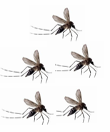
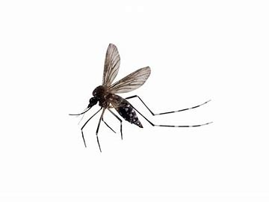
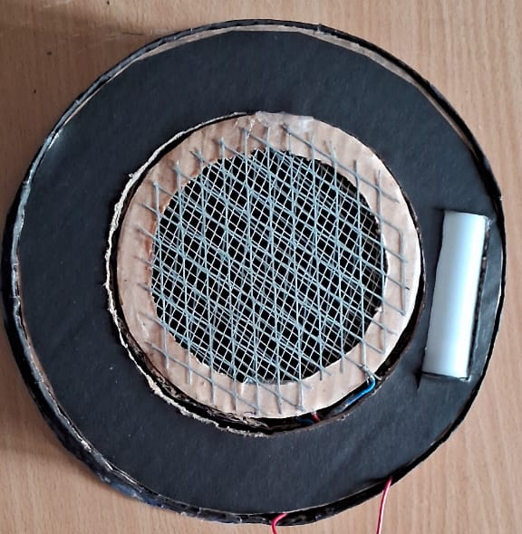

Work Flow
Paste + UV
(Attractants)
Paste odour
Electrified grid
Mosquitoes are shocked to death upon landing on the electrified grid
Mosquito attracted by the paste and UV
UV light
Mosquitoes are Attracted
Electrocuted mosquito

Slide 7
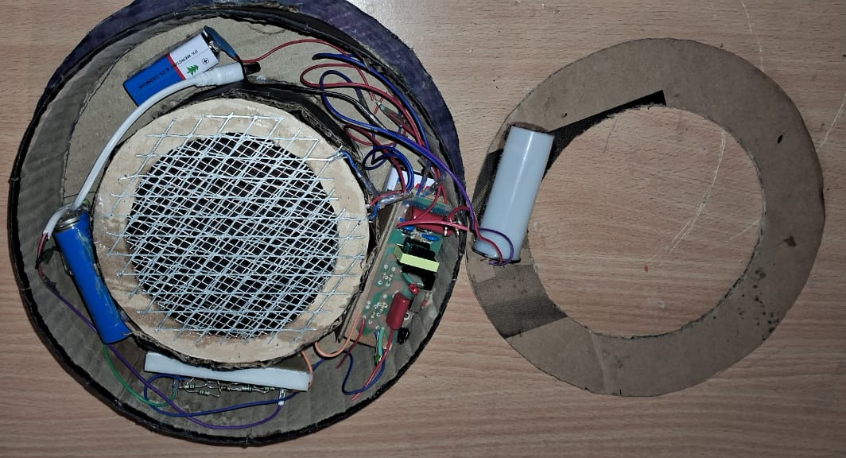
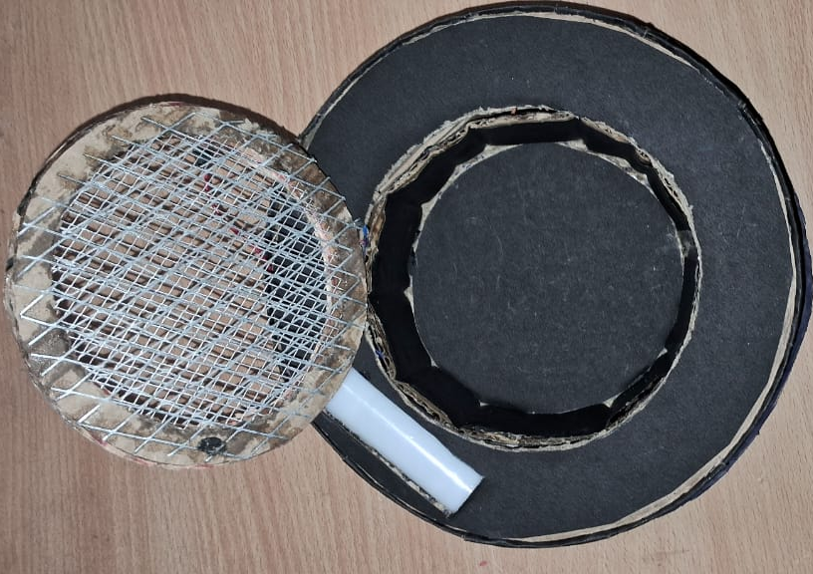
Prototype

Slide 8
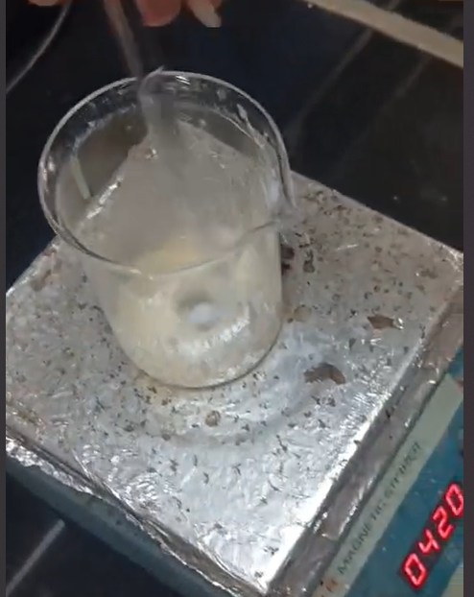
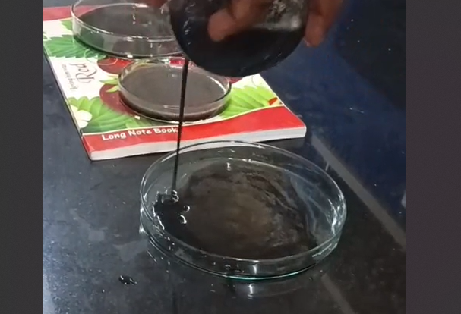
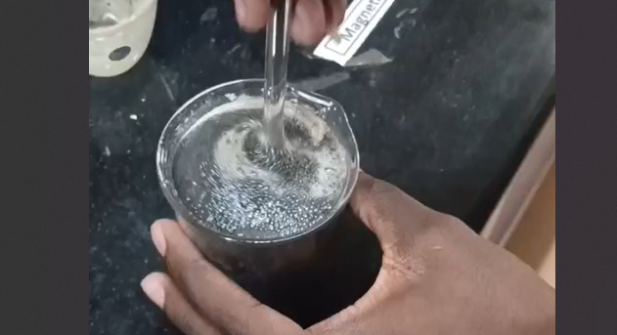
Paste Preparation

Slide 9
Working model/simulation video

Slide 10
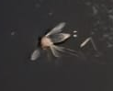
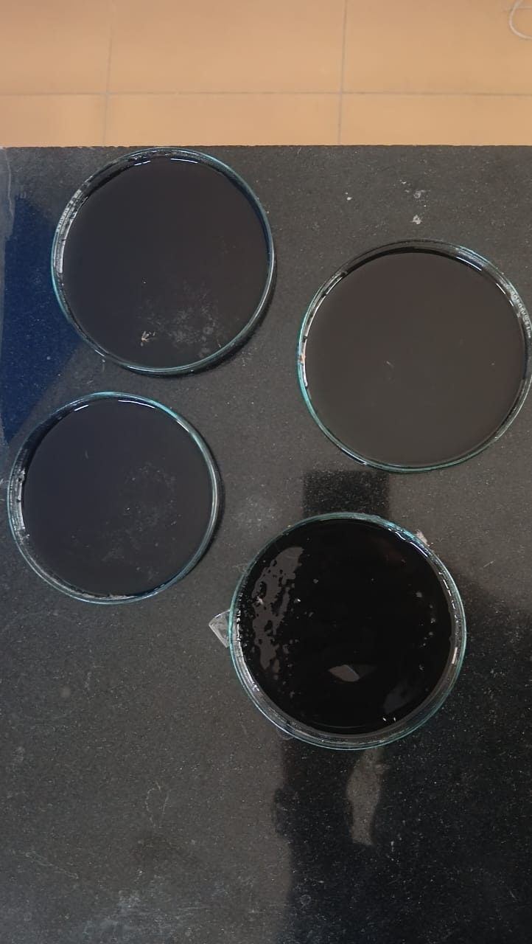
Results
Key findings include:
• Improved Attraction – The combination of CO₂, natural scents, and UV light enhanced the system's ability to attract mosquitoes.
• Immediate Elimination – The high-voltage grid provided swift extermination.
• Demonstrated Reliability – Controlled tests confirmed its potential for large-scale application.

Slide 11
Claims (We Filed a Patent)
Dual-Attractant System – Utilizes CO₂, volatile compounds, and warmth to attract mosquitoes efficiently.
Integrated Extermination – Features a commercial high-voltage zapper circuit for immediate mosquito eradication.
Power Efficiency – Functions on a single power setting to ensure consistent, low-energy use.
Real-World Application – Affordable and adaptable for residential, outdoor, and high-risk environments.
Enhanced Lure Efficiency – A fermented attractant paste increases CO2 production, outperforming typical traps.

Slide 12
Conclusion
This model offers a practical solution for decreasing malaria-related deaths and curbing the transmission of diseases carried by mosquitoes. By combining a chemical lure with an electrocution mechanism, it effectively eliminates mosquitoes. Its affordable and scalable design makes this system an effective method for mosquito control, suitable for use in homes, public areas, and regions at high risk.

Slide 13


